Slide 1


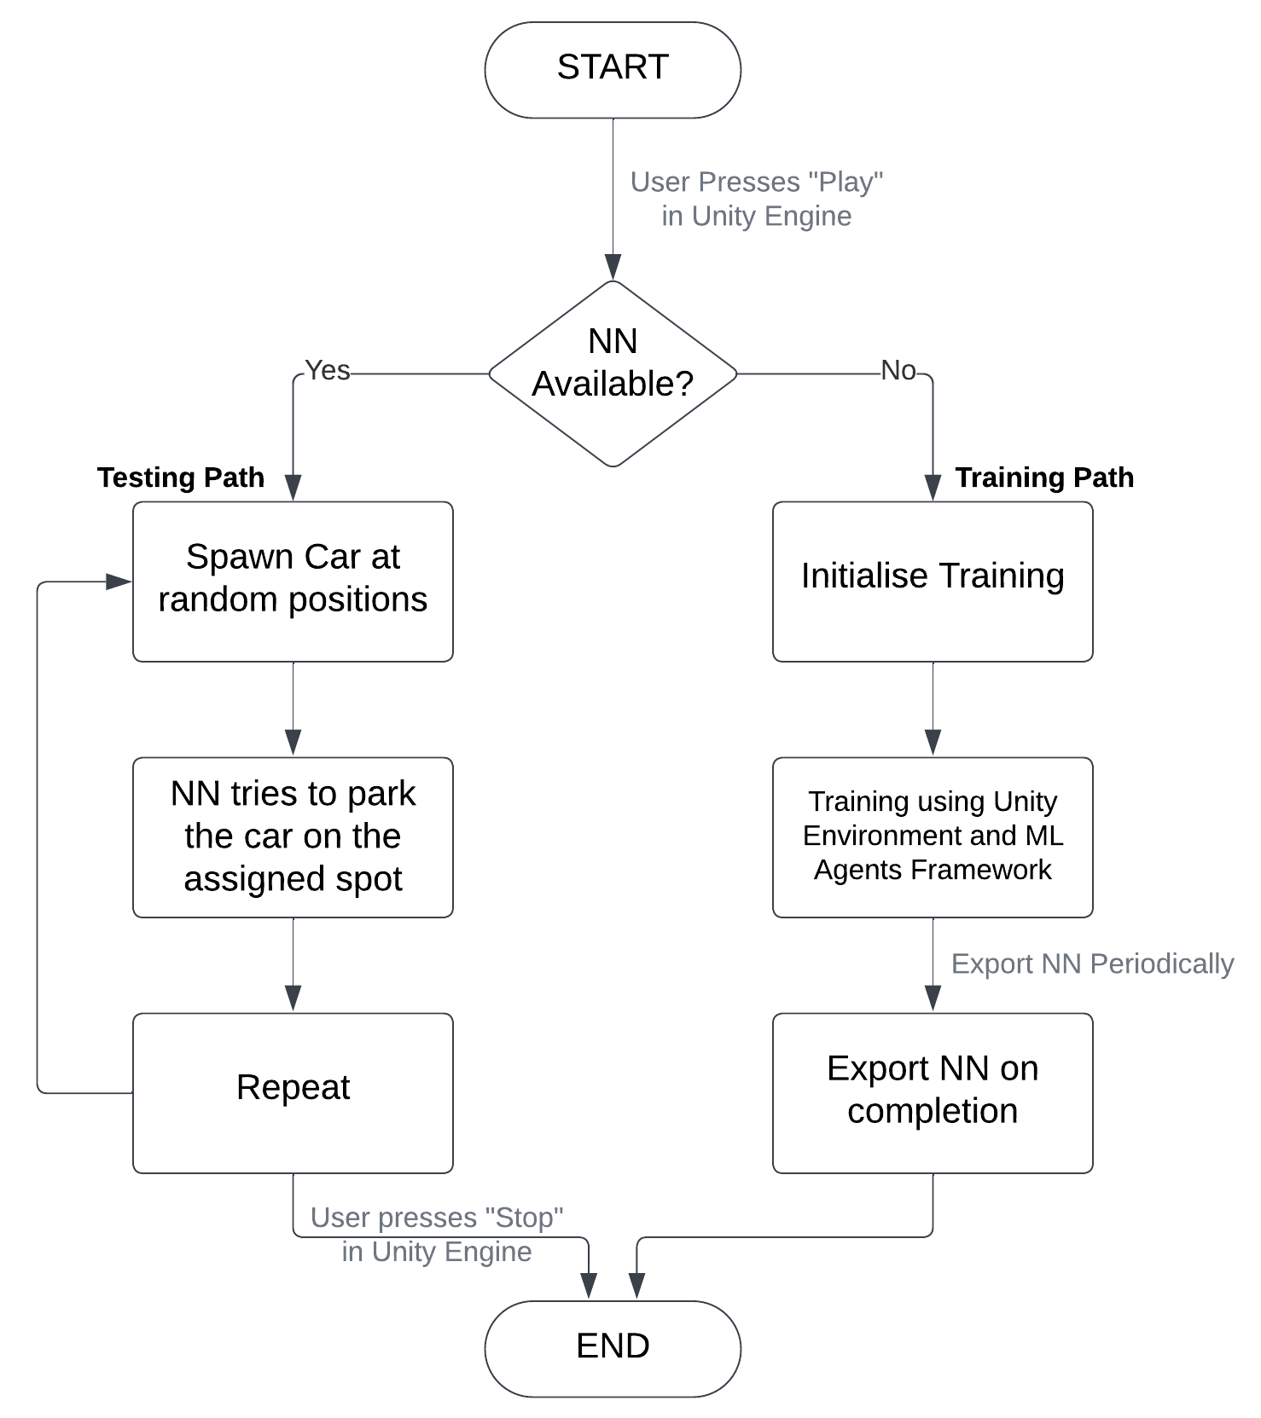
iPark: Intelligent Parking
Kushagra, Abhinav Sajjan, Himanshu Mishra, Shreyashi Jaiswal
Department of Computer Science and Engineering
Dr A P J Abdul Kalam Technical University, Lucknow | Ajay Kumar Garg Engineering College, Ghaziabad
ABSTRACT
This project describes how RL agents in the Unity Environment can perform autonomous parking. The goal is to propose a method that uses reinforcement learning techniques offered by the Unity ML-Agents framework within Unity’s realistic 3D simulation to solve the requirement for autonomous parking solutions. The suggested solution’s design, execution, and assessment are highlighted in the project report. The system offers an adaptive and realistic system for autonomous parking in complex situations.
WORKING
CONCLUSION
Through the integration of RL algorithms with the Unity ML-Agents framework, the iPark system can learn to navigate dynamic parking scenarios, adapt to changing environments, and make real-time decisions based on sensory inputs. By training the system on a diverse range of parking scenarios, the iPark system can learn robust policies that generalize well across different environments.
INTRODUCTION
This project encompasses the development of an autonomous car parking system using Reinforcement Learning (RL) within the Unity simulation environment. The primary focus is on training a virtual agent to autonomously navigate and park a car in diverse scenarios, emulating real-world challenges. The system will address various aspects of automated parking, including spatial awareness, trajectory planning, and real-time decision-making. Also, Evaluate the performance of the trained RL agent based on key metrics, including success rate, parking accuracy, and computational efficiency.
RESULTS
16-05-2024 14:34:04 (Testing Model "iPark Export [02] 06-05-2024") Efficiency 89.37852% Total Park 31539 Total Collision 3748 Total Cases 35287
REFERENCES
Juliani, A., Berges, V.-P., Teng, E., Cohen, A., Harper, J., Elion, C., Goy, C., Gao, Y., Henry, H., Mattar, M., Lange, D. (2020). Unity: A General Platform for Intelligent Agents.
ACKNOWLEDGEMENT
I would like to thank my project guide, Mr Samender Singh, for his invaluable guidance, patience, and encouragement.

